Slide 1
Chapter 5
Connecting Through a Wireless Network

Slide 2
Object
• Explain current wireless networking technologies
• Discuss the history of wireless networks and their advantages
• Describe radio wave technologies
• Explain 802.11 radio wave networking
• Describe the Bluetooth and HiperLAN radio wave technologies
• Discuss infrared wireless technologies
• Explain wireless MAN networking through WiMAX and HiperMAN
• Explain cellular phone communications
• Describe terrestrial and satellite microwave technologies
• Consider design options for wireless network
http://fpt.edu.vn

Slide 3
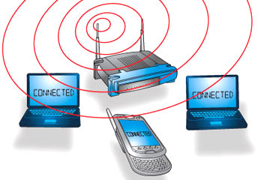
A Short History of Wireless Networks
Packet radio: early PC networking over radio waves
  Developed by amateur (ham) radio operators
  Built around TNC (terminal node controller)
Wireless standards develop in parallel with ham radio
  1985: Industrial, Scientific, Medical (ISM) band opened
  Telecommunications Act of 1996
  IEEE 802.11 standard set in 1997
A few of the entities influencing standards
  IEEE (Institute of Electrical and Electronics Engineers)
  IETF (International Engineering Task Force)
  ISO (International Organization for Standardization)
http://fpt.edu.vn

Slide 4
Advantages of Wireless Networks
Needs accommodated by wireless networks
  Enabling communications in remote areas
  Reducing installation costs
  Providing “anywhere” access
  Simplifying small office and home office networking
  Enabling data access to fit the application
http://fpt.edu.vn

Slide 5

Saving Money and Time
Factors favoring choice of wireless over cable
  Expense, speed, safety, low impact
Scenario: network supporting university fundraiser
  Extra network connections needed for new staff
  Installation of new cables not practical
    Expensive proposition
    Not possible within time frame
  Solution: install wireless network
    Saves time and money
    Reduces likelihood of sustaining injury
    Preserves historic character of structures
http://fpt.edu.vn

Slide 6
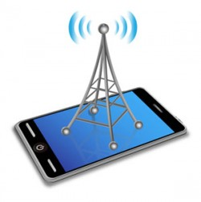
Radio Wave Technologies
Frequency ranges of various transmission types
  AM: 535–1605 kilohertz (kHz)
  FM: 88–108 megahertz (MHz)
  Network: 902-928 MHz, 2.4-2.4835 GHz, 5-5.825 GHz
Directional signal transmitted between buildings
  Transmission involves sending and receiving antennas
  Wave is short in length and low-power (1-10 watts)
  Suitable for line-of-sight transmission
    Signal goes from point to point on earth's surface
    Limitations due to interruptions, such as hills
  Data capacity range: 54 Mbps to 6000 Mbps
http://fpt.edu.vn

Slide 7
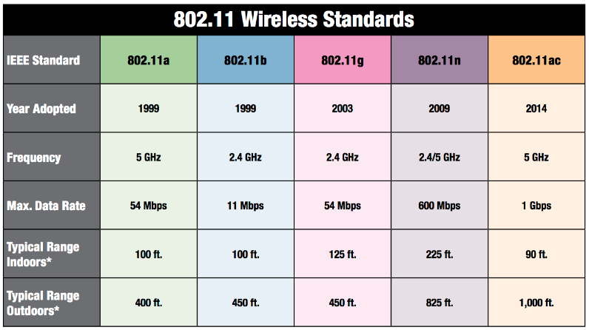

IEEE 802.11 Radio Wave Networking
IEEE 802.11 group: most influential wireless standards
http://fpt.edu.vn

Slide 8
IEEE 802.11 Radio Wave Networking
Communication with 802.11 devices is non-proprietary
Features of 802.11 standards
  Encompass either fixed or mobile wireless stations
  Involve two kinds of communications
    Asynchronous: discrete units with start and stop bit
    Synchronous: signal has timing restrictions
  Support SNMP protocol and network authentication
  Operate at two lower OSI layers: Data Link and Physical
  Recognize indoor and outdoor wireless communication
http://fpt.edu.vn

Slide 9
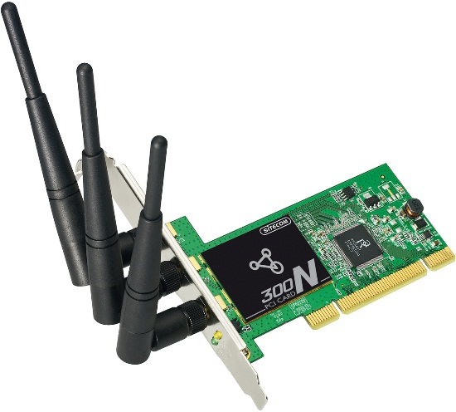
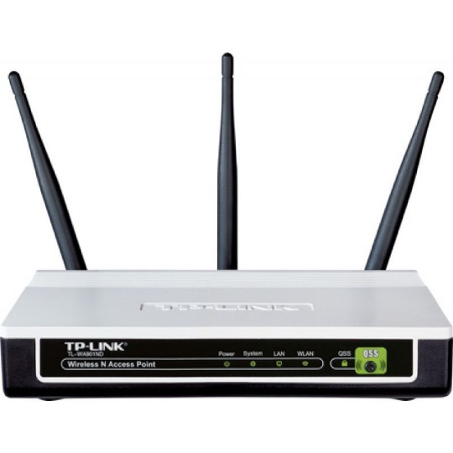
Wireless Components
Three components: transceiver, access point, antenna
Wireless NIC (WNIC): transceiver card
  Functions as transmitter and receiver
  Operates at Physical and Data Link layers of OSI model
  May be internal (PCI card) or external (USB key fob)
  Compatible with NDIS and ODI specifications
    Enable multiple protocols
    Interface computer with WNIC
Access point: interfaces WNIC and cable network
  Examples: bridge, switch, or router
Antenna: device radiates and receives radio waves
http://fpt.edu.vn

Slide 10
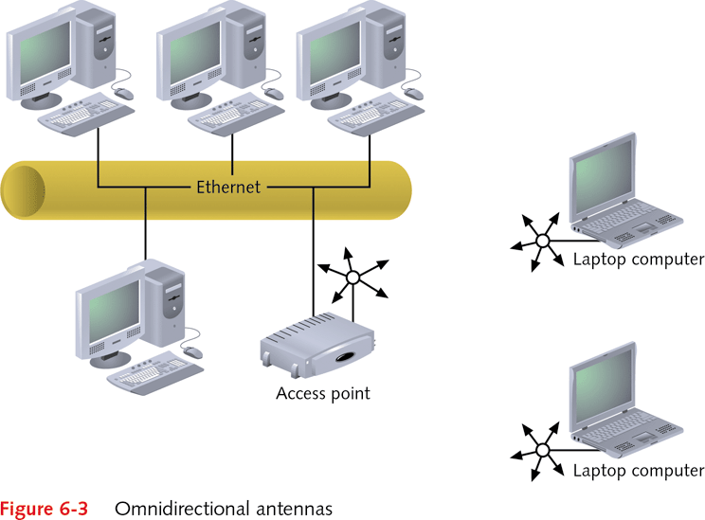
http://fpt.edu.vn

Slide 11
Wireless Networking Access Methods
Two access methods: priority-based and CSMA/CA
Priority-based access (or point coordination function)
  Intended for time-sensitive communications
  Access point functions as point coordinator
  Point coordinator establishes contention-free period
  Method revolves around contention-free period
Carrier Sense Multiple Access with Collision Avoidance (CSMA/CA)
  Also called the distributed coordination function
  CSMA/CA works to avoid collisions
  Coordinate nodes using DIFS delay and backoff time
http://fpt.edu.vn

Slide 12

802.11a
Outlines speeds in 5 GHz frequency range
  Minimum speed: 6 Mbps
  Maximum speed: 54 Mbps
Uses Orthogonal Frequency Division Multiplexing (OFDM)
How OFDM radiates data signal over radio waves
  Divides 5 GHz range into 52 subcarriers (subchannels)
    Four subcarriers used for control
    48 subcarriers host data
  Splits data over 52 subcarriers
  Transmits data in parallel over 52 subcarriers
http://fpt.edu.vn

Slide 13
802.11b
Outlines speeds in the 2.4 GHz frequency range
  Minimum speed: 1 Mbps
  Maximum speed: 11 Mbps
Uses Direct Sequence Spread Spectrum (DSSS)
How DSSS radiates data signal over radio waves
  DSSS spreads data across any of up to 14 channels
    Each channel up to 22 MHz in width
  Number and frequency of channels based on country
  Data signal sequenced over channels
  Data signal amplified for gain
Barker Code/CCK enhance DSSS over 5.5 Mbps
http://fpt.edu.vn

Slide 14
802.11g
Allows three transmission methods on 2.4 GHz band
  OFDM (native mode)
    Similar to OFDM under 802.11a (different bands)
    Minimum speed: 6 Mbps
    Maximum speed: 54 Mbps
  Complementary Code Keying (CCK)
    Used with DSSS for backward compatibility with 802.11b
    Minimum speed: 1 Mbps
    Maximum speed: 11 Mbps
  Packet Binary Convolution Code (PBCC)
    Unofficial extension for 802.11b
    Offers speeds of 22 Mbps and 33 Mbps
http://fpt.edu.vn

Slide 15
802.11g (continued)
Restrictions and considerations using 802.11g
  Devices must support minimum speeds by standard
    Speed values: 1, 2, 5.5, 6, 11, 12, and 24 Mbps
  Slightly shorter range than 802.11b
    More access points may be needed
  Smaller bandwidth (90 MHz) than 802.11a or 802.11b
    No more than three access points in given area
  Devices combine with 802.11b devices on one LAN
    Advantage: retain earlier investment in 802.11b
    Disadvantage: lowers network performance
http://fpt.edu.vn

Slide 16
Shared Key Authentication and Wired Privacy (WEP)
Employs Wired Equivalent Privacy (WEP)
WEP encryption key
  Consists of key, checksum, initialization information
  Total key length is 64- or 128-bits
    128-bit key supports superior 128-bit encryption
  Up to four WEP keys can be stored in key index
Authenticating using shared key and WEP
  Sender requests authentication from another station
  Contacted station sends back challenge text
  Sender encrypts challenge text, returns to challenger
  If returned text properly decoded, verification sent
http://fpt.edu.vn

Slide 17
Wi-Fi Protected Access (WPA)
Uses WEP-like features, but encrypted keys change
  Key changes make WPA more secure than WEP
WPA2 is latest version
Preshared key (PSK): WPA enhancement
  Targeted for home and small networks
Setting up PSK network security
  Ensure option supported on WNIC and devices
  Enter password (master key when installing access point)
  After password entered, WPA automatically activated
  All wireless devices must use the same password
http://fpt.edu.vn

Slide 18
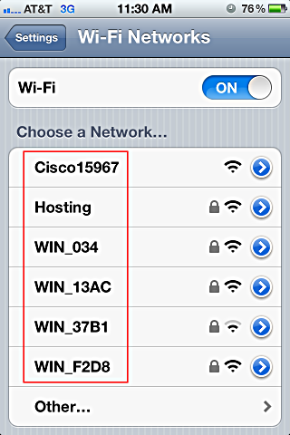
Service Set Identifier
SSID: identification value up to 32-bits in length
  Value defines logical network for all member devices
Examples of SSIDs
  Series of random characters
  String identifying network purpose, such as "Atmospheric Research"
SSID often configured by default
  Ensure that vendor default is replaced
  Use SSID value difficult to guess
http://fpt.edu.vn

Slide 19
802.1x and 802.11i Security
802.1x: wireless and wired authentication approach
  Port-based form of authentication
  Ports over which connection made act in two roles
    Uncontrolled: allows unauthenticated communications
    Controlled: allows only authenticated communications
  Node roles: supplicant and authenticator
Disadvantage: authentication process not encrypted
802.11i adds three features to enhance 802.1x
  Temporal Key Integrity Protocol (TKIP)
  Advanced Encryption Standard (AES)
  Robust Secure Network (RSN)
http://fpt.edu.vn

Slide 20
802.11 Topologies
Independent basic service set (IBSS) topology
  Consist of two or more stations in direct communication
  Peer-to-peer communication between WNICs on nodes
  Stations often added on impromptu basis
Extended service set (ESS) topology
  Deploys one or more access points
    Enables more extensive area of service than the IBSS
  Network sizes range from small to large
IBSS network easily expanded to ESS network
  Caveat: avoid combining networks in same proximity
http://fpt.edu.vn

Slide 21
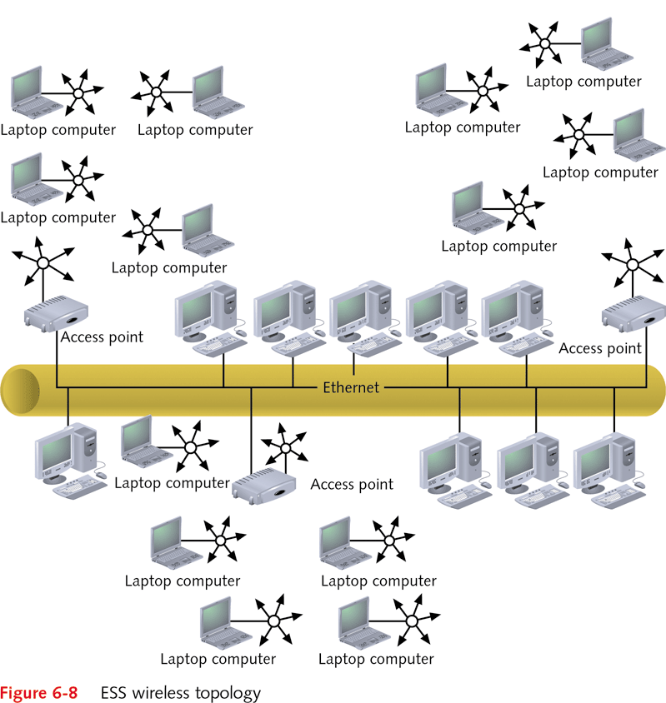
http://fpt.edu.vn

Slide 22

Alternative Radio Wave Technologies
Three popular alternatives to 802.11 group
  Bluetooth
  HiperLAN
  HomeRF SWAP
Alternative standards supported by specific vendors
http://fpt.edu.vn

Slide 23
Bluetooth
Defined through the Bluetooth Special Interest Group
Characteristics
  Uses Frequency Hopping Spread Spectrum (FHSS)
    Frequency hopping: packets hop among 79 frequencies
    Occurs in 2.4 GHz range (2.4–2.4835 GHz)
  High wattage transmission from 10 to 100 meters
  Can use asynchronous or synchronous communication
  Uses time division duplexing (TDD)
    Packets sent in alternating directions using time slots
Many kinds of wireless products use Bluetooth
  Examples: PDAs, keyboards, mice, printers, others
http://fpt.edu.vn

Slide 24
HiperLAN
High-performance radio local area network
Features of second version, HiperLAN2
  Transmits at up to 54 Mbps in the 5 GHz range
  Compatible with Ethernet and ATM
  Supports Data Encryption Standard (DES)
  Supports Quality of Service (QoS)
HiperLAN2 operates in two modes
  Direct: peer-to-peer similar to 802.11 IBSS topology
  Centralized: certain access points centralize control
Both HiperLAN2 modes use TDD
http://fpt.edu.vn

Slide 25
Infrared Technologies
Broadcasts in single direction or all directions
Advantages of infrared medium
  Inexpensive
  Difficult to intercept
  Not prone to RFI or EMI
Disadvantages of infrared medium
  Slow data transmissions
  Does not penetrate walls
  Experiences interference from strong visible light
Diffused infrared: reflects infrared light from ceiling
  Defined by IEEE 802.11R standard
  Communication with pulse position modulation (PPM)
http://fpt.edu.vn

Slide 26
Wireless MANs
Based on IEEE 802.16 standard (WiMAX)
  Provides connectivity up to 75 Mbps
  Has a reach of up to 30 miles
WiMAX called connection for "last mile"
  Connects home or office to wired network provider
Implementing WiMAX for rural office
  Install wireless communication at network provider
    Include a directional or omnidirectional antenna
  Connect directional antenna to wireless router in office
  Point office antenna to provider's antenna
http://fpt.edu.vn

Slide 27
Satellite Microwave
Transmits signal between three antennas
  One antenna on a satellite in space
Connection speed at 1.5 Mbps
  May be "throttled" down for uploading large files
  Also vary due to weather, signal strength, usage
User equipment needed for satellite communication
  Satellite dish about 2 or 3 feet in diameter
  Digital modems to transmit and receive signals
  Coaxial (TV-like) cables from the modems to dish
  Serial/USB cable from modems to serial/USB ports
  Software from provider to enable computer setup
http://fpt.edu.vn

Slide 28
Satellite Microwave (continued)
Geosynchronous satellites
  Orbit at 22,300 miles above the Earth
  Orbital position stationary with respect to earth
  Extreme distance can cause transmission delays
Low Earth orbiting (LEO) satellites
  Orbit between 435 and 1000 miles above the Earth
  Facilitate faster transmission of two-way signals
Uses of satellite networks
  Broadband (high-speed) Internet communications
  Around-the-world video conferencing
  Classroom and educational communications
  Other communications involving voice, video, data
http://fpt.edu.vn

Slide 29
Q & A
http://fpt.edu.vn

